Slide 1
Workplace Project - Forecasting the returns of a portfolio of 2 shares, taking into account their dependency structure
By Yaj Jugnarain

Slide 2
Table of contents
Introduction & Problem Statements
Data Overview & Preprocessing
Exploratory Data Analysis
Further Analysis & Visualisations
Core Methodologies & Modeling
Practical Application
Conclusion

Slide 3

Introduction
Welcome to the Workplace Project, where statistical modeling transforms portfolio risk forecasting. This initiative combines powerful analytical techniques—ARIMA, GARCH, and Copula models—to uncover key portfolio metrics like mean terminal value, standard deviation, and Value-at-Risk (VaR). By integrating trends, volatility, and asset dependencies, this project creates a robust framework for optimising investment strategies and understanding financial dynamics. Let's dive in!

Slide 4
Problem Statements
Forecasting Trends and Returns:
How can we accurately predict the future returns of a portfolio composed of two shares (Nvidia and Apple) while accounting for their unique market behaviors?
Dependency Analysis:
How can we effectively model the dependency structure between the two assets to understand their joint behavior and its impact on portfolio dynamics?
1
3
Modeling Volatility:
Given the high volatility of financial markets, how can we capture and quantify fluctuations in asset prices to assess the overall portfolio risk?
Risk Estimation & Portfolio Optimisation
How can we calculate key portfolio risk metrics, such as Value-at-Risk (VaR) and standard deviation, under normal market conditions to assist in decision-making? What is the optimal weight allocation between the 2 assets to maximize returns while minimizing risk, based on statistical modeling outputs?
2
4

Slide 5
Data Overview & Preprocessing
2

Slide 6


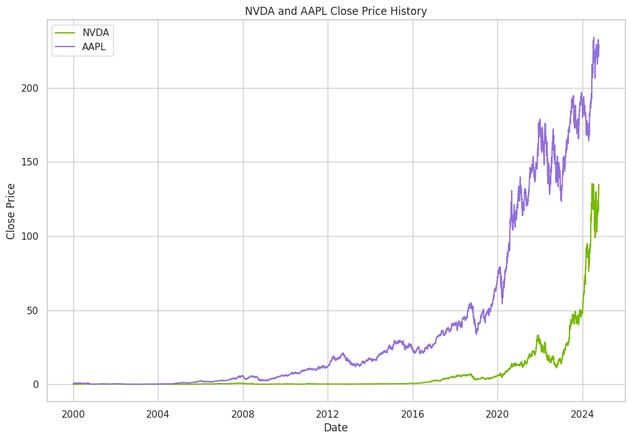
Data Overview & Preprocessing [1 / 3]
Historical price data from Yahoo Finance for Apple Inc. (AAPL) and Nvidia Corporation (NVDA), both listed on NASDAQ was used. Key components include:
Chosen Data Range
Data spans January 2015 to October 2024, approximately 10 years.
This range balances historical context with current trends, ensuring relevance for forecasting.
Relevance of Data Span:
Older data may not reflect current market dynamics, especially in the fast-changing technology sector.
A balanced data range is crucial: not too far back, but capturing sufficient historical trends.
Growth Patterns:
Apple Inc. (AAPL): Exhibits linear growth from 2009–2015, followed by exponential growth post-2015.
Nvidia Corp. (NVDA): Shows exponential growth starting in 2021, reflecting the booming demand for AI and semiconductors.
Extreme Events Captured in Data:
Dot-com Bubble Crisis: Peaked in March 2000.
Global Financial Crisis: 2007–2008.
COVID-19 Pandemic: Early 2020 and beyond.
These events introduce unique market disruptions and influence trends.

Slide 7
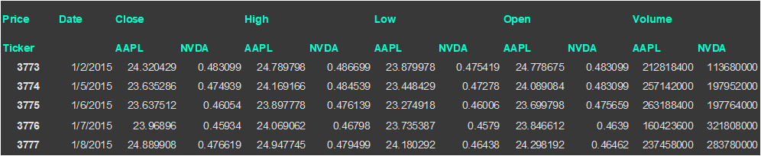
Data Overview & Preprocessing [2 / 3]
A snapshot of the data is provided below and consists of each of the following fields for both AAPL and NVDA:
Date: The trading date.
Close: Final price at which a share is traded at the end of a trading day (used for analysis).
Adj Close: Adjusted closing price that reflects dividends, stock splits, and offerings.
High and Low: The highest and lowest prices reached during a trading day.
Opening: The initial price at which the share traded on a given day.
Volume: Total number of shares traded during the day.
Close Price is chosen for analysis to maintain simplicity and relevance from which log returns are calculated to:
Stabilise variance.
Normalize the data for better adherence to model assumptions.
Pre-Cleanup Step: Calculating log returns prior to data cleanup enables the identification of abnormal values, which are essential for ensuring robust analysis.
:

Slide 8
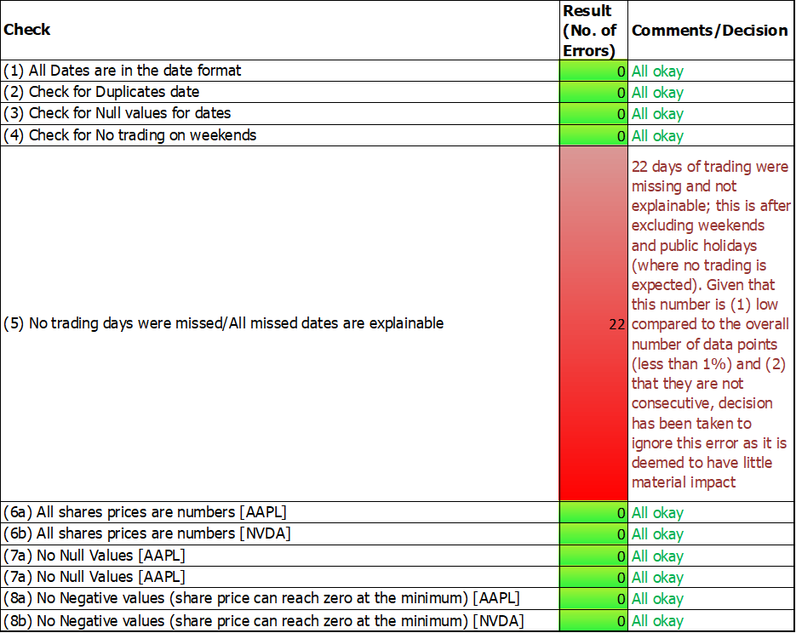
Data Overview & Preprocessing [3 / 3]
A battery of data checks were performed in excel before proceeding with further analysis (See adjoined table).
Issue Identified: During data validation in Excel, 22 trading days were found to be missing (after excluding weekends and public holidays). The cause was not explainable.
Impact Assessment:
The missing data points constitute less than 1% of the dataset.
They are non-consecutive, minimizing potential bias in the analysis.
Decision: Given the low material impact, the missing days have been ignored, and the dataset is deemed sufficiently robust for further analysis.

Slide 9
Exploratory Data Analysis
3

Slide 10
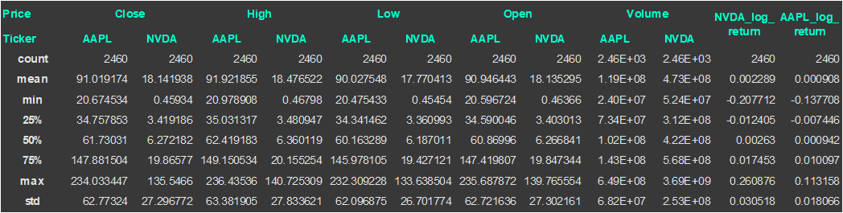
Exploratory Data Analysis [1 / 4]
Below are the summary statistics for the AAPL and NVDA data, including the log returns:
Key observations are:
Maximum/Minimum Returns:
Apple (AAPL):
The highest/lowest log returns occurred during the COVID-19 pandemic, reflecting heightened volatility.
Nvidia (NVDA):
Maximum Return (Nov 2016): Attributed to record revenue, margins, and earnings driven by strong product performance across all lines.
Minimum Return (2018): Coincided with a decline in demand for GPUs, following a drop in cryptocurrency value.
Mean Returns - both assets had mean log returns close to zero, indicating relatively stable growth over the long term.

Slide 11
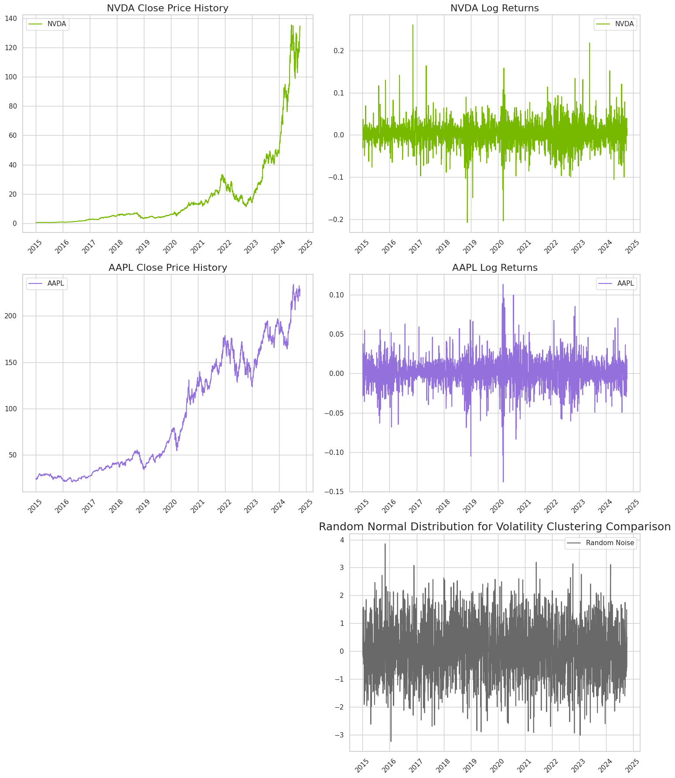
Exploratory Data Analysis [2 / 4]
To evaluate whether the log returns exhibit volatility clustering, we compare them to white noise data, which has no predictable patterns of fluctuation.
Log Returns:
AAPL and NVDA exhibited higher fluctuations in 2020, a period marked by significant market uncertainty during the COVID-19 pandemic.
Prolonged periods of high and low volatility validate the presence of volatility clustering, indicating dependency across time.
Random Noise Series:
The generated random noise displays no discernible patterns, reflecting consistent randomness without prolonged periods of fluctuation.

Slide 12
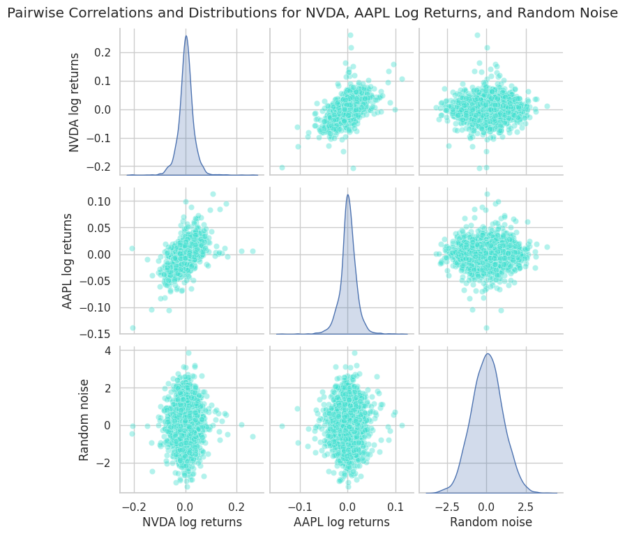
Exploratory Data Analysis [3 / 4]
We then move on to Kernel Density Estimation (KDE) and pairwise correlation plots for the data.
Key Observations:
Leptokurtic Density Functions - The log return distributions for AAPL and NVDA exhibit fatter tails compared to the normal distribution (leptokurtic behavior). This indicates that extreme values occur with higher probability than suggested by a normal distribution.
GARCH Models are crucial for capturing this behavior, effectively modeling the variance and volatility clustering.
AAPL and NVDA share positive correlation in their log returns, reflecting a degree of dependency.
The log returns of both assets have low correlation with the random noise series (close to zero).
This highlights the importance of capturing dependencies between the two assets for accurate portfolio modeling.

Slide 13
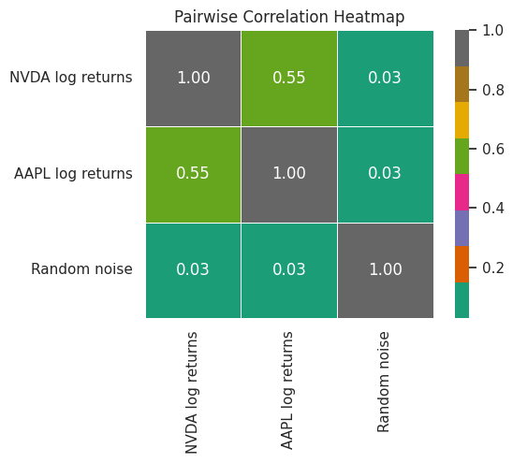
Exploratory Data Analysis [4 / 4]
The previous analysis is further reinforced when we quantify the correlation coefficient between each series of log returns with that between NVDA and AAPL being 0.55.

Slide 14
Further Analysis & Visualisations
4

Slide 15
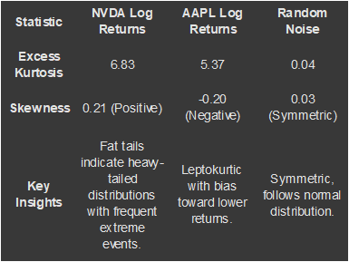
Further Analysis & Visualisations [1 / 3]
In the realm of financial data, one of the stylised facts that stands out is the phenomenon of "fat tails."
Unlike the tails of a normal distribution, fat tails indicate that extreme events—such as large jumps or drastic drops in asset prices—occur more frequently than what a normal distribution would predict.
This heavy-tailed behavior reflects the increased likelihood of rare but significant market movements, posing both opportunities and risks for traders and investors. The presence of fat tails is a critical factor in risk management, as it underscores the need for models that can better capture the true distribution of financial returns, ensuring that extreme events are adequately anticipated and mitigated.
We drive the following key insights:

Slide 16
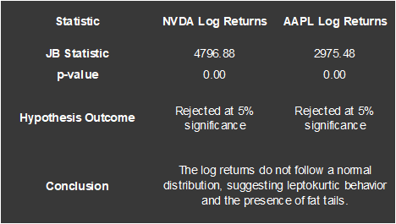
Further Analysis & Visualisations [2 / 3]
To test for the normality of the returns, we can also use the Jarque-Bera test. The Jarque-Bera test is a goodness-of-fit test that determines if sample data have the skewness and kurtosis matching a normal distribution. From the test results,
In each case, the null hypothesis of normality for the log returns is rejected at the 5% significance level.

Slide 17
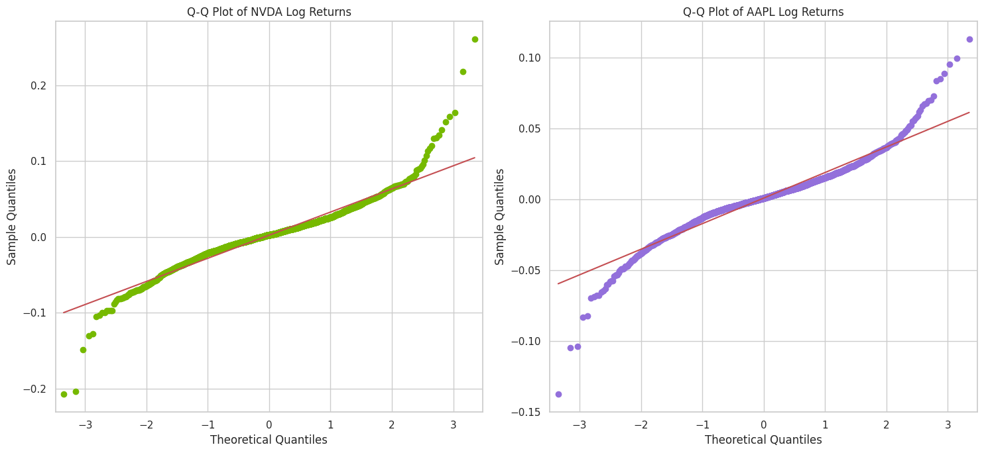
Further Analysis & Visualisations [3 / 3]
The 'fat tailness' of the log returns are also illustrated in the below Q-Q plots which show deviations from the expected behaviour at the tails.

Slide 18
Core Methodologies & Modeling
5

Slide 19
Core Methodologies & Modeling [1 / 19]
Based on the results derived in the previous sections, we are going to use the following methodology and adhere to the below process:
ARIMA (AutoRegressive Integrated Moving Average):
Captures linear trends, patterns, and seasonality in the individual share time series data.
Forecasts future values based on historical data, enabling a deeper understanding of long-term asset behavior.
ARIMA models rely on three components: autoregression (AR), differencing to make the data stationary (I), and moving averages (MA).
GARCH (Generalized Autoregressive Conditional Heteroskedasticity):
Models volatility clustering, which is common in financial markets, focusing on time-varying variance.
Provides crucial insights into the risk and uncertainty surrounding each asset.
It assumes that current volatility depends on past periods' volatility and residual errors, allowing for better modeling of changing variances over time.
Copula Models:
A powerful statistical tool for modeling dependency structures between the two shares.
Simulates the joint behavior of assets to assess portfolio dynamics and correlations.
Copulas are functions that capture the dependence structure between random variables. Copulas allow for modeling complex relationships between variables, even when marginal distributions differ.

Slide 20
Core Methodologies & Modeling [2 / 19]
The process flow is as follows:

Slide 21
Core Methodologies & Modeling:
Fitting the ARIMA model
5

Slide 22
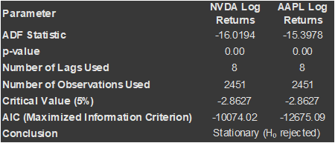
Core Methodologies & Modeling [3 / 19]
Fitting the ARIMA model
Testing for Unit Root and Stationarity:
We begin by assessing if the log returns are stationary. If a time series is non-stationary, it means its statistical properties—such as mean, variance, and autocovariance—change over time, which complicates analysis and forecasting.
The Augmented Dickey-Fuller (ADF) Test is key for assessing stationarity.
If the test statistic is more negative than the critical value, the null hypothesis (presence of a unit root) is rejected, meaning the series is stationary.
If stationarity is not achieved, differencing is applied to transform the series into a stationary one.
In each case the null hypothesis of a unit root for the log returns is rejected at the 5% significance level.

Slide 23
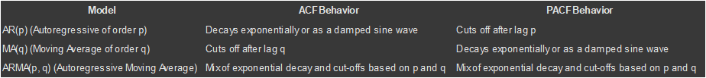
Core Methodologies & Modeling [4 / 19]
b) Determining the order of the ARIMA
After determining that no differencing is required, we then proceed with determining the order of the ARIMA to be fit.
We plot the Autocorrelation Function (ACF) to identify possible MA (Moving Average) and the Partial Autocorrelation Function (PACF) to identify possible AR (AutoRegressive) components.
Generally, we expect:
Unfortunately, from the graphs (see next slide) it is quite difficult to determine the order of the ARMA as whilst there a few lags that seem significant, they do not particularly stand-out.

Slide 24
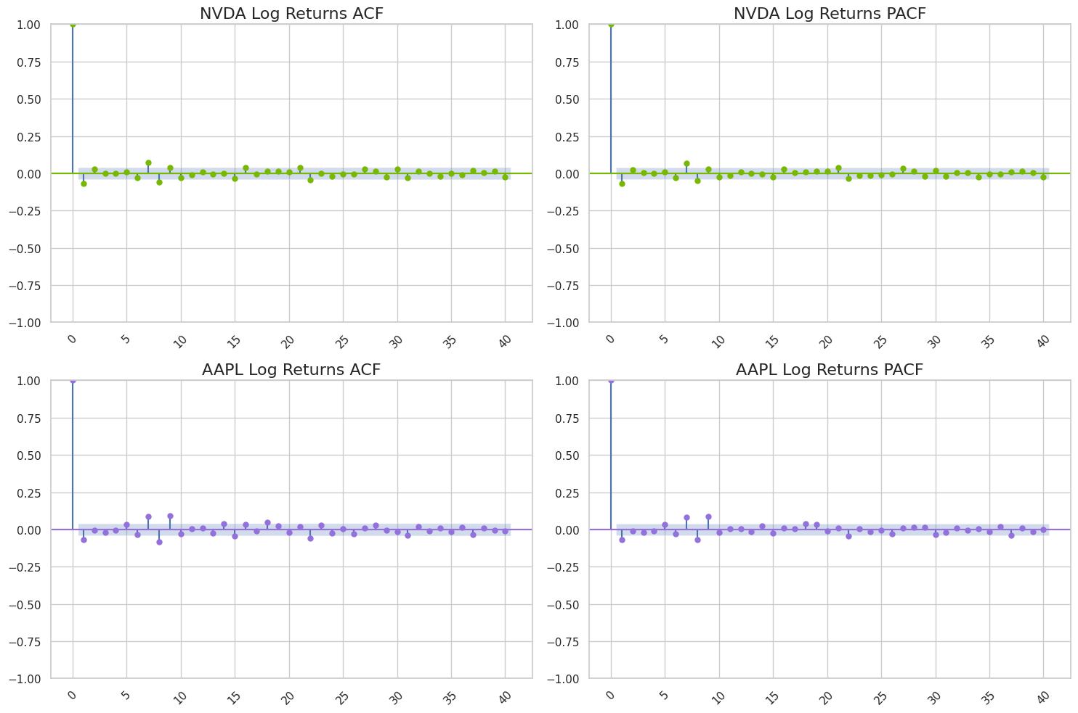
Core Methodologies & Modeling [5 / 19]
b) Determining the order of the ARIMA (continued)

Slide 25
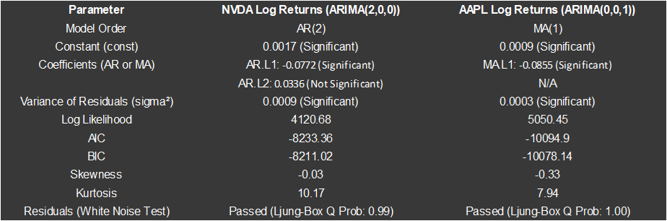
Core Methodologies & Modeling [6 / 19]
b) Determining the order of the ARIMA (continued)
The AutoArima from the pdarima library to determine a starting ARIMA model.
To note that before fitting the ARIMA ,odels, we have split the data into train (80% of the data) and test (remaining 20%).
Testing on the test dataset assesses the model's ability to generalise and forecast future values. This prevents overfitting, where the model performs well on training data but fails on unseen data.
This yields an ARIMA (2,0,0) for NVDA and an ARIMA (0.0,1) model for AAPL.

Slide 26
Core Methodologies & Modeling [7 / 19]
b) Determining the order of the ARIMA (continued)
Key Observations:
NVDA (ARIMA(2, 0, 0)):
Significant term: AR.L1; AR.L2 is not significant.
Constant term suggests a small but significant mean return.
Residual diagnostics indicate non-normality and heteroskedasticity.
AAPL (ARIMA(0, 0, 1)):
Significant term: MA.L1.
Constant term is significant.
Similar issues with non-normality and heteroskedasticity in residuals.
Residual Variance (σ²):
Both models have low residual variance, suggesting reasonable fit.
Refinement needed to address residual diagnostics and ensure robustness.
Given that the second AR term is not significant for NVDA, we consider simplifying the model by removing the insignificant term and see whether it improves model performance or keeps it similar while simplifying the model structure.

Slide 27
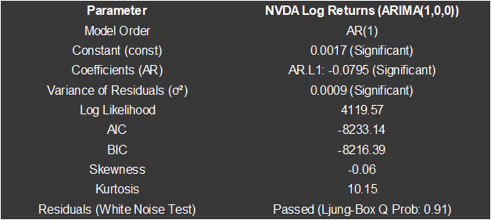
Core Methodologies & Modeling [8 / 19]
b) Determining the order of the ARIMA (continued)
Key Observations:
Removing the insignificant term decreases the maximum log-likelihood. The AIC registers very little change while the BIC becomes more negative (better) - this is because the BIC tends to favour more parsimonious models (i.e. ones with less parameters) to a greater extent than the AIC.
The AIC (Akaike Information Criterion) and BIC (Bayesian Information Criterion) are used to evaluate and compare statistical models:
AIC: Measures the goodness of fit of a model while penalizing for complexity (number of parameters). Lower AIC values indicate a better balance between fit and simplicity.
BIC: Similar to AIC but imposes a harsher penalty for models with more parameters, favoring simpler models as the sample size increases.

Slide 28
Core Methodologies & Modeling:
Fitting the GARCH model
5

Slide 29
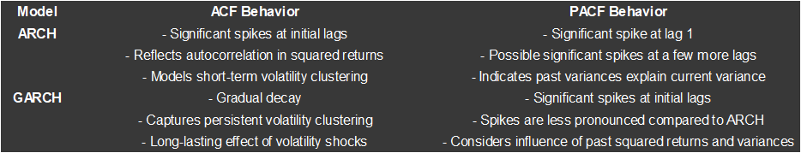
Core Methodologies & Modeling [9 / 19]
Fitting the GARCH model
Determining the order of the GARCH model:
To determine the order of the GARCH model for each log returns series, we can use the ACF and PACF plots, but this time on the squared log returns.
Squared returns are used as a proxy for volatility, reflecting fluctuation magnitude and exhibit positive autocorrelation capturing periods of high/low volatility clustering.
The below behaviour is expected for a GARCH process:

Slide 30
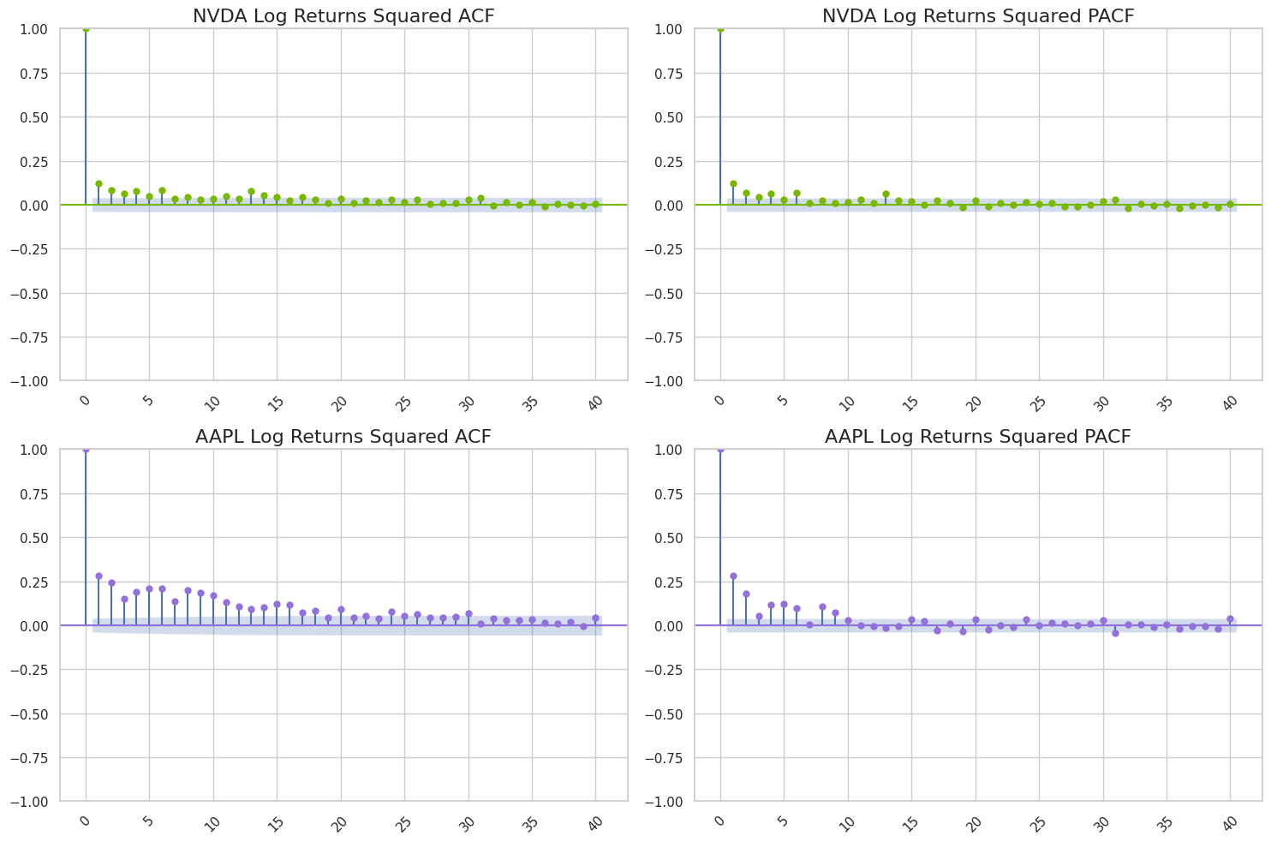
Core Methodologies & Modeling [10 / 19]
Determining the order of the GARCH model (continued)
Based on the ACF/PACF plots
NVDA:
GARCH order is challenging to determine definitively.
PACF shows mixed significance across multiple lags.
ACF does not display clear patterns, making it harder to interpret.
Volatility clustering is evident but with unclear influences from past variances.
AAPL:
GARCH(2,0) appears suitable based on patterns.
PACF shows significant spikes at lags 1 and 2, indicating their importance.
ACF exhibits gradual decay, reflecting persistent volatility clustering.
Beyond lag 2, spikes reduce as higher lags are explained by the first two terms, though some remain significant.
For NVDA, we fit a GARCH (1, 1) model while for AAPL we fit a GARCH (2, 0) model as indicated by the ACF and PACF plots. These are fitted to the residuals from the ARIMA models.

Slide 31
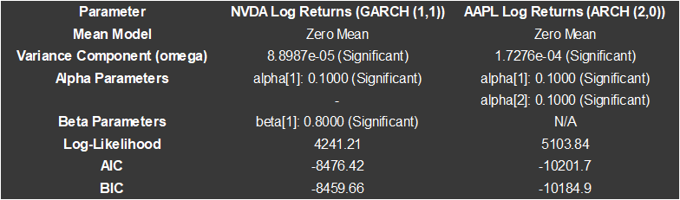
Core Methodologies & Modeling [11 / 19]
Determining the order of the GARCH model (continued)
Summary of the results for the GARCH models:
Key Observations:
Baseline Volatility (omega): Both models incorporate significant constant variance components.
Volatility Clustering:
NVDA: Strong influence of past squared residuals (alpha[1]) and past variances (beta[1]).
AAPL: Significant influence of past squared residuals (alpha[1] and alpha[2]), typical for ARCH models.
Model Fit: Low AIC and BIC values suggest good model performance.
R² Explanation: Not meaningful in GARCH/ARCH models, as they focus on volatility prediction rather than direct time-series values.

Slide 32
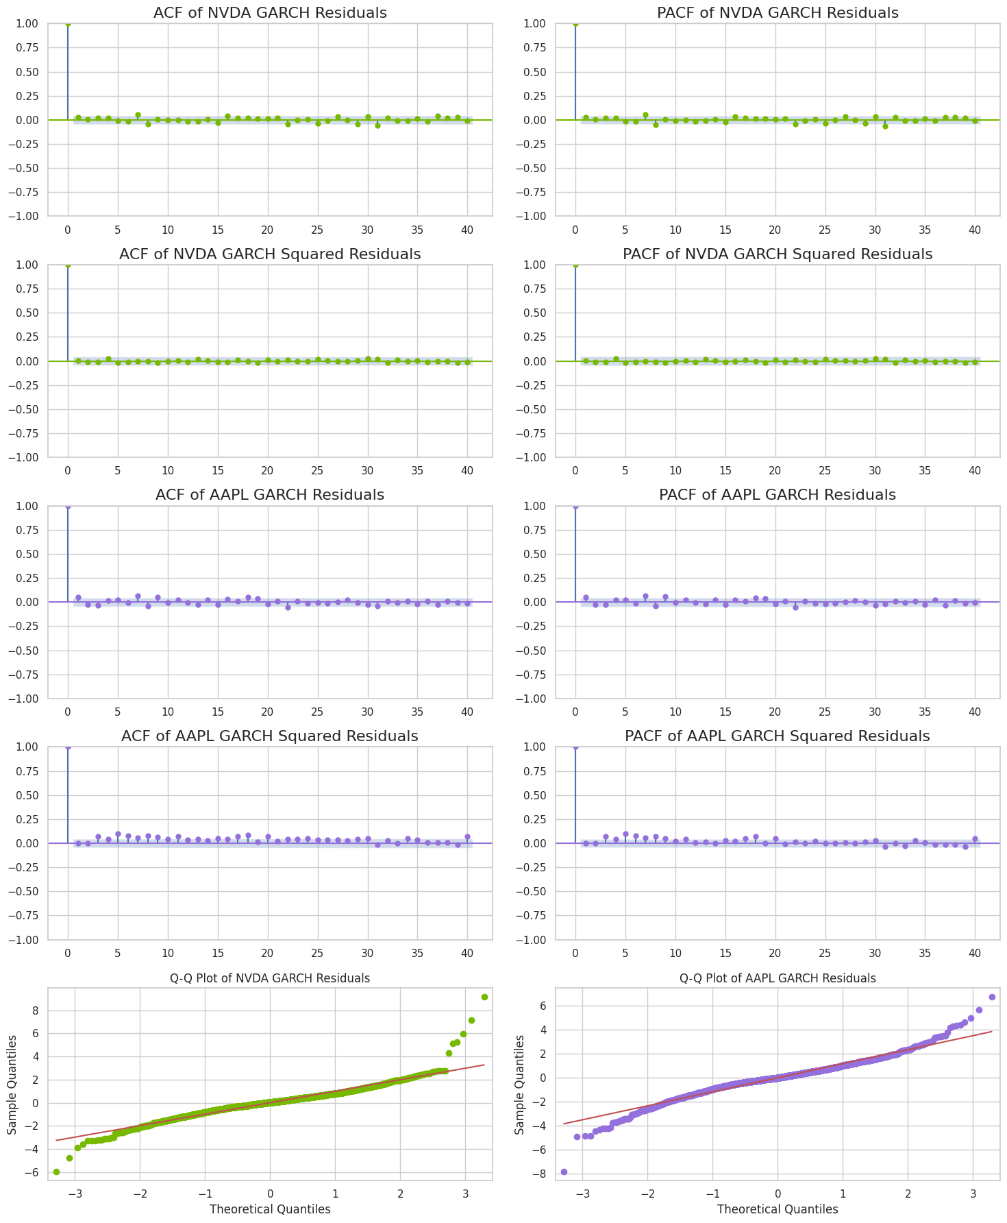
Core Methodologies & Modeling [12 / 19]
Determining the order of the GARCH model (continued)
Now that we have the ARIMA-GARCH models for each of NVDA and AAPL, we check whether we have captured all the salient features in the data.
Key Observations:
The ACF and PACF of the residuals and squared residuals for NDVA seem to indicate that most of the salient features have been taken care. However for AAPL the squared residuals still exhibit some significant lags - although much less than before.
The Q-Q plots do seem to exhibit some improvement, with the deviations at the 'tails' being less; the points lie closer to the line in each case - we further ascertain this by checking the kurtosis of the residuals. For NVDA, the excess kurtosis from the GARCH residuals is 0.209 while for AAPL it is -0.196. Both show a marked improvement showing that the GARCH models are able to capture heavy tails.
We need to test higher order GARCH models to see if there is any improvement.

Slide 33
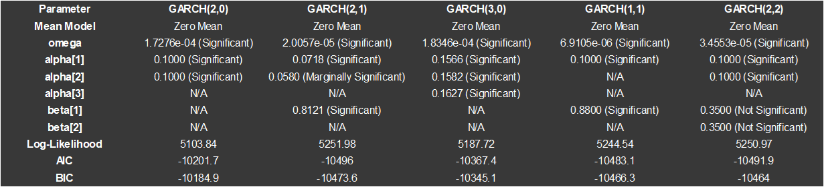
Core Methodologies & Modeling [13 / 19]
Determining the order of the GARCH model (continued)
The results of the various GARCH models fit for AAPL are as follows:
Key Observations:
GARCH (2,1) and GARCH (1,1) display strong performance with significant parameters and lower AIC/BIC values compared to others.
GARCH (3,0) captures additional volatility effects but has a slightly higher AIC/BIC.
GARCH (2,0) is simpler but still significant for short-term variance effects.
GARCH (2,2) includes additional beta parameters, but they are not statistically significant, potentially making it less optimal.
Models with beta terms such as GARCH (2,1) and GARCH (1,1) outperform ARCH-like models (GARCH (2,0) and GARCH (3,0)) in capturing volatility persistence.
GARCH (2,2) is excluded from further analysis due to insignificant beta terms.
Overall, the GARCH (2,1) model provides the best fit overall, capturing both short-term and long-term volatility dynamics effectively; balancing complexity and performance.
The GARCH (1,1) model is a strong alternative, being more parsimonious and nearly as effective.

Slide 34
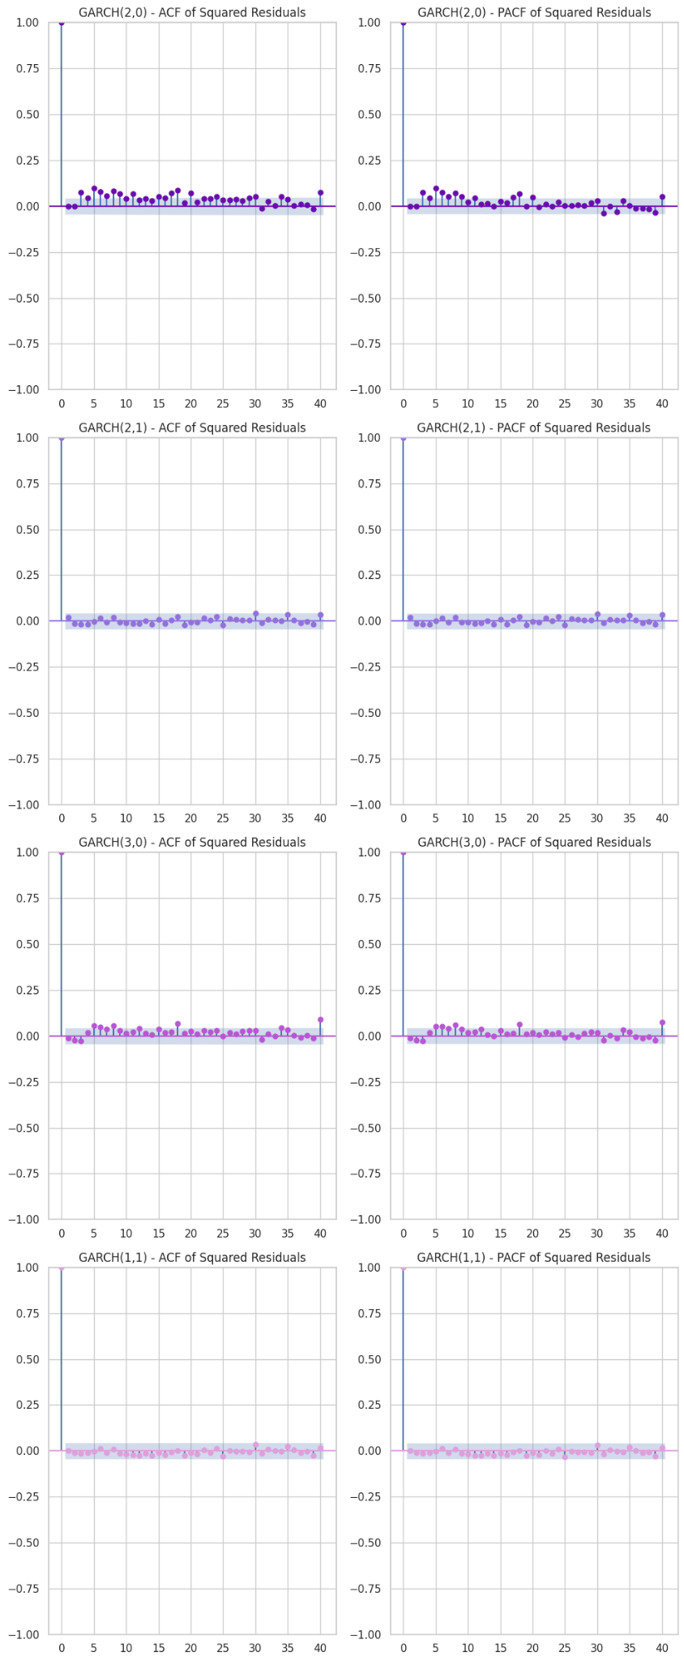
Core Methodologies & Modeling [14 / 19]
b) ARIMA-GARCH model diagnostics
We also recheck this using the ACF and PACF plots.
Key Observations:
From the plots, the GARCH (1,1) and the GARCH (2,1) perform the best.
Based on this and the above model results, it seems sensible to use the GARCH (2,1) to model the volatility of AAPL.
We can hence conclude that an AR(1)-GARCH(1,1) model is suitable for NVDA while an MA(1)-GARCH(2,1) model is suitable for AAPL.

Slide 35
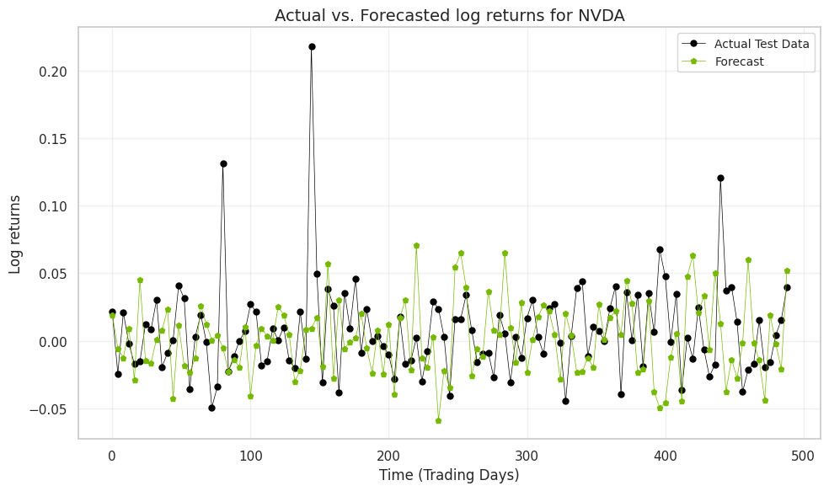
Core Methodologies & Modeling [15 / 19]
b) ARIMA-GARCH model diagnostics (continued)
We then proceed by testing simulated log returns from each fitted ARIMA-GARCH model versus actual test data. We inspect the fit using both the Mean Squared Error (MSE) and the Mean Absolute Error (MAE), as well as gauge it visually.
Key Observations:
NVDA:
The MSE value of 0.00196 suggests that the squared differences between actual and predicted values are relatively small. This reflects good forecasting performance, especially for financial time series data where achieving low error is challenging.
The MAE value of 0.0346 shows that, on average, the absolute difference between actual and predicted values is modest. This further supports the effectiveness of the combined ARIMA-GARCH model.
The simulated NVDA log returns follow a similar pattern to that of the actual data. There are a few extreme observations present in the actual data which this sets of simulated log returns does not exhibit however.

Slide 36
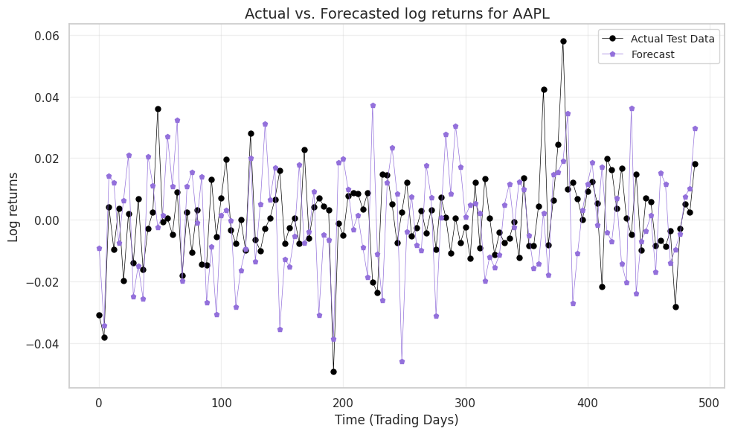
Core Methodologies & Modeling [16 / 19]
b) ARIMA-GARCH model diagnostics (continued)
AAPL:
The MSE value is 0.000528, which indicates very small average squared errors between actual and predicted values. This suggests that the combined ARIMA-GARCH model has achieved a high level of accuracy in forecasting for this dataset.
The MAE value is 0.0181, which highlights that the average absolute differences between the forecasts and actual values are minimal. This further confirms that the model is capable of producing precise predictions.
The simulated AAPL log returns follow a similar pattern to that of the actual data. Contrary to for NVDA, in this case the log returns exhibit the same level of 'extreme' spikes/lows as the actual data.

Slide 37
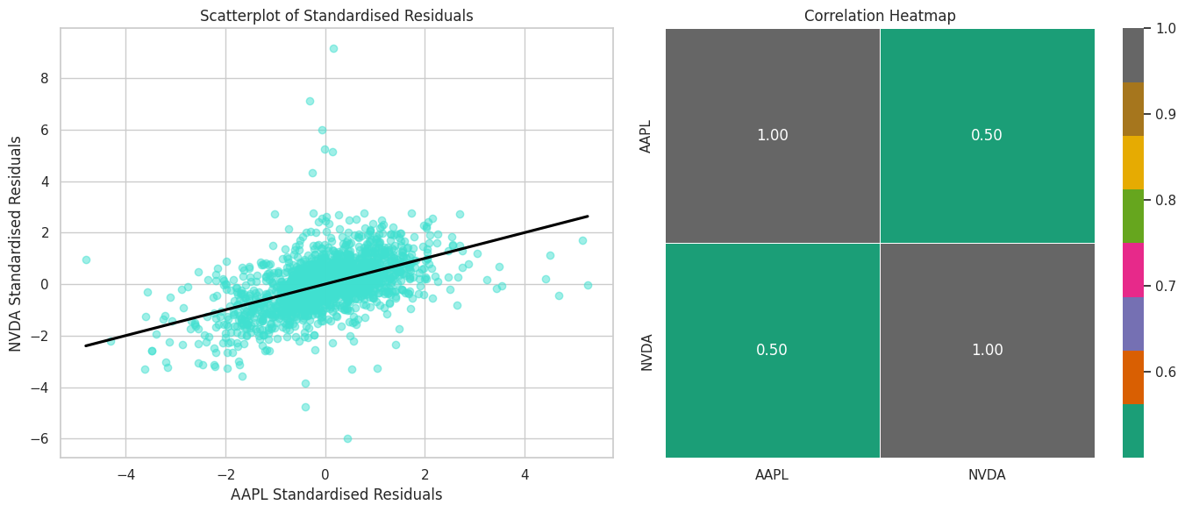
Core Methodologies & Modeling [17 / 19]
b) ARIMA-GARCH model diagnostics (continued)
We also determine the correlation between the residuals of the ARIMA-GARCH model. This is 0.50, which is close to what we determined for the log returns (0.56).
Our simulated values achieves only -0.02; the dependency structure was not considered.
The ARIMA-GARCH models perform well on their own, but they do not cater for the dependence shown between the shares historically. Hence why we need Copulas.

Slide 38
Core Methodologies & Modeling:
Fitting the Copula model
5

Slide 39
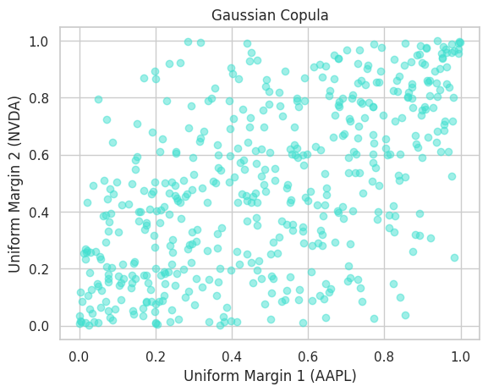
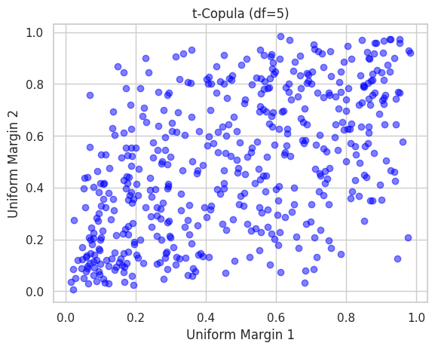
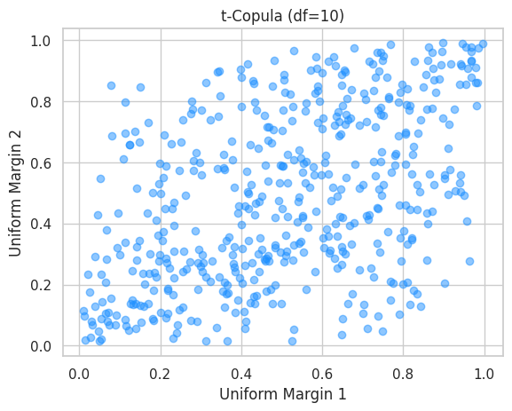
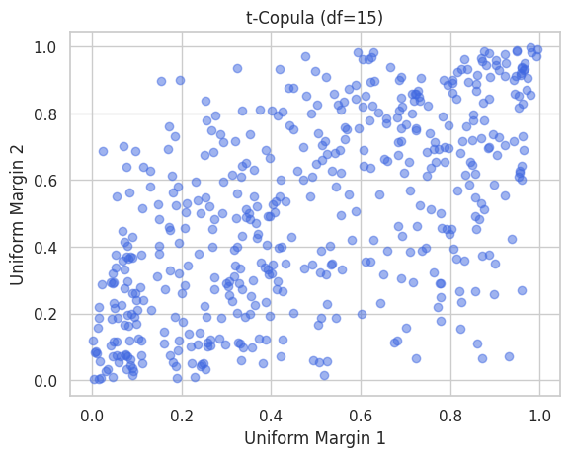
Core Methodologies & Modeling [18 / 19]
The steps followed for the Copula were:
Data Transformation:
Transform residuals into uniform marginal distributions using the Probability Integral Transform.
Enables easier modeling of dependencies.
Choice of Copula:
Gaussian Copula: Suitable for symmetric relationships.
Archimedean Copula: Flexible for asymmetric dependencies.
t-Copula: Captures tail dependencies (extreme values co-occurring). This is determined by the degrees of freedom (df) of the t-Copula.
Fit the Copula
Fit the chosen copula to the data to estimate dependency structure parameters.
Adjoined are some of the results of the Copulas fitted visually.

Slide 40
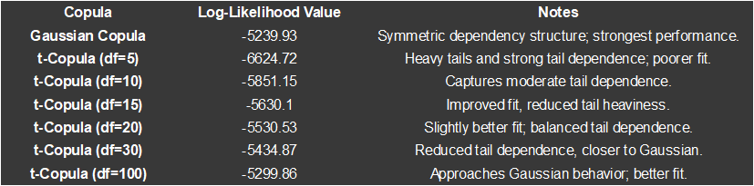
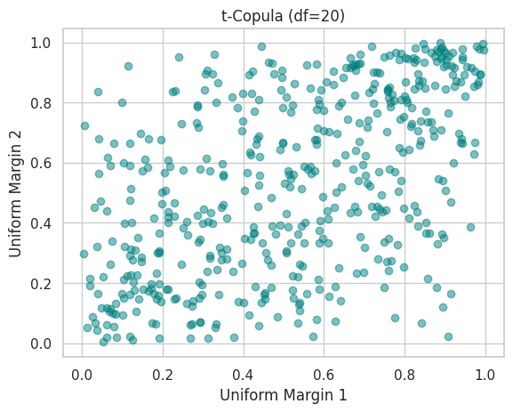
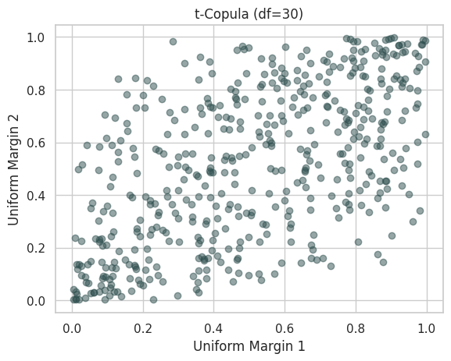
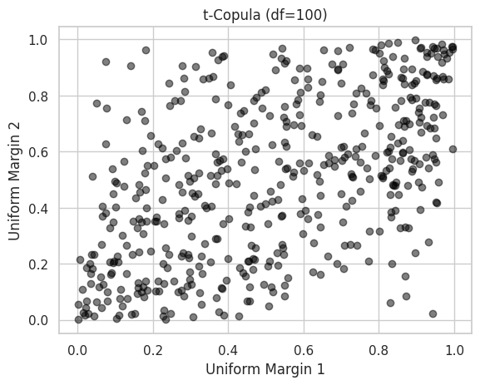
Core Methodologies & Modeling [19 / 19]
The fit was determined on which Copula maximises the log-likelihood function:
The Gaussian Copula achieved the highest Log-Likelihood, suggesting it better captures the dependency structure of the data.
Lower degrees of freedom in t-Copulas result in heavier tails and strong tail dependence, making them less optimal for this dataset.
As the degree of freedom increases, t-Copulas approximate Gaussian behavior, improving fit.

Slide 41
Practical Applications
6

Slide 42
Practical Applications [1 / 5]
The main purpose of building such a model is to be able to forecast/simulate the pathways for the log returns of NVDA and AAPL;.
To do so, we follow these steps:
Random draws are made from the Gaussian Copula fitted. These consist of 2 series of draws, 1 for each of NVDA and AAPL.
Transformation to Uniform Margins:
The Gaussian samples are transformed into uniform samples using the cumulative distribution function (norm.cdf). This preserves the correlation while converting data into a uniform scale.
Residual Scaling:
Residuals are scaled using GARCH-estimated conditional volatilities. This ensures the residuals reflect time-varying volatility.
Combination of ARIMA and GARCH Residuals:
The ARIMA forecasted mean values are adjusted with scaled residuals to account for both the deterministic ARIMA pattern and stochastic volatility modeled by GARCH.
The results for 1 such simulation is depicted in the next slide.

Slide 43
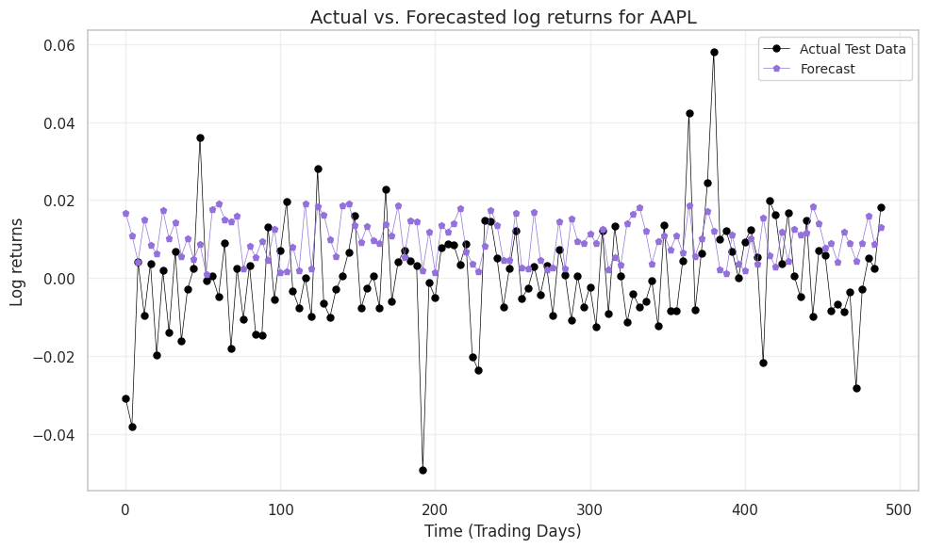
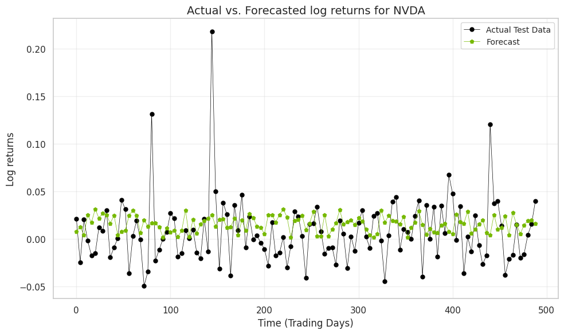
Practical Applications [2 / 5]
For this simulation:
AAPL:
Mean Squared Error (MSE): 0.0003489
Mean Absolute Error (MAE): 0.01447
NVDA:
Mean Squared Error (MSE): 0.00123
Mean Absolute Error (MAE): 0.02643
Correlation between AAPL and NVDA forecasts: 0.5633
For both, the simulated returns do not capture the degree of 'extreme' spikes/lows in the actual test data. This is likely for this simulation only as we observed that for AAPL, the previous 'separate' simulated log-returns did exhibit some degree of extreme log returns. To curtail this, it is best to perform multiple simulations and not just rely on one.
The correlation between AAPL and NVDA of 0.56 is close to that observed for the GARCH residuals (0.50).

Slide 44
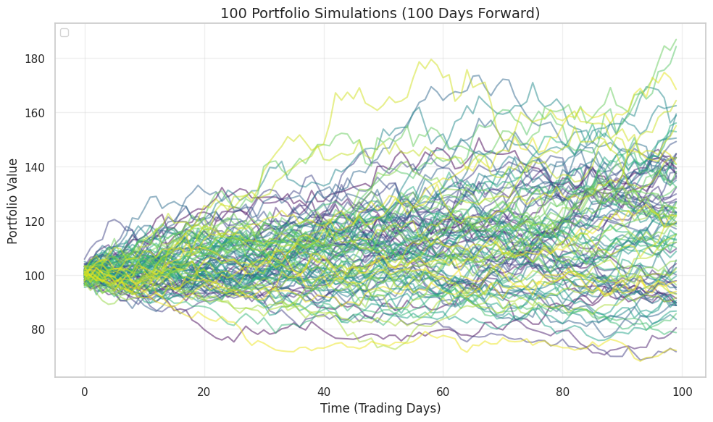
Practical Applications [3 / 5]
Forecasting
We can repeat the previous simulation to obtain multiple pathways for each of NVDA and AAPL.
Using this, we can also build the future portfolio values (up to 100 trading days forward here) of a portfolio consisting of an equal mix of NVDA and AAPL shares. To keep things simple, we have assumed both shares to be valued at 100 on day 0.
We have displayed only 100 simulations here, but 10, 000 simulations were performed to derive insights.

Slide 45
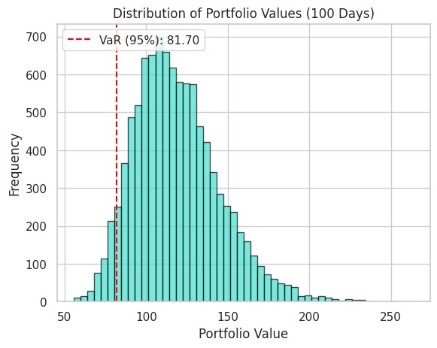
Practical Applications [4 / 5]
Risk Return Profile
From the simulations, we can note the following:
In 100 days, the portfolio has an expected value of 118.98 with a standard deviation of 26.29. This gives a view of the risk-return profile of the portfolio. We can equally, gauge the downside risk of the portfolio using the Value-at-Risk.
Value at Risk (VaR) is a widely used risk management measure that quantifies the potential loss in value of a portfolio or investment over a specified time period, given a certain level of confidence.
We can interpret the VaR here as: 95% of the time, we do not expect the value to fall beneath 81.70 after 100 days
.
.

Slide 46
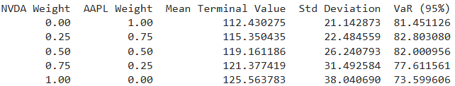
Practical Applications [5 / 5]
Portfolio Optimisation
We can optimise the risk-return profile of the portfolio by allocating different weights to NVDA and AAPL in the portfolio.
The mean terminal value increases as the portfolio allocation shifts toward NVDA. This indicates that NVDA offers higher average returns compared to AAPL over the 100-day horizon:
Risk (as measured by standard deviation) increases as NVDA weight increases. NVDA introduces higher variability in portfolio outcomes compared to AAPL:
The VaR (95%) decreases as NVDA's weight increases, reflecting more downside risk than for AAPL-heavy portfolios. At full allocation to NVDA, the portfolio's worst-case loss scenario at that confidence level has a terminal value of 73.60, compared to 81.45 for AAPL.
While NVDA provides higher returns, it also introduces increased tail risk, as seen in the significant drop in VaR.
A balanced portfolio (50-50 split) offers a compromise between risk and return, providing a mean terminal value of 119.16 with moderate standard deviation (26.24).
Investors with a higher risk tolerance might favor a heavier allocation to NVDA for higher returns, despite the increased volatility and lower VaR.
.
.

Slide 47
Conclusion
7

Slide 48
Conclusion
This project demonstrates the forecasting of portfolio risk and performance using a blend of statistical techniques tailored to financial data. By leveraging ARIMA models for trend and seasonality analysis, GARCH models for capturing volatility clustering, and Copulas for modeling dependencies between assets, we established a robust framework for understanding and managing portfolio dynamics.
Through practical applications, we analyzed a portfolio composed of Apple Inc. and Nvidia Corporation, showcasing how these methods can predict future asset behaviors, optimise weight allocations, and quantify risks like Value-at-Risk (VaR). This blend of tools not only provides insights into individual asset behavior but also reveals the interconnectedness crucial for portfolio management.
As financial markets continue to evolve, the combination of these models offers a dynamic and adaptive approach to risk forecasting and decision-making. The project highlighted the importance of combining statistical rigor with practical applications, paving the way for more informed investment strategies and robust risk management practices.
.
.

Slide 49
Thank you.

